Slide 1
Midterm Presentation
Kelsey DiCarlo, Lauren kieffer, lawino Lurum

Slide 2
Load Data
Step One

Slide 3
NYC Taxi Rides
Reviewed the NYC Cabs data frame
We loaded and previewed the data in our Jupyter notebook
Original Data set included the following column headings:
Id
vendor_id
pickup_datetime
dropoff_datetime
passenger_count
pickup_longitude
pickup_latitude
dropoff_longitude
dropoff_latitude
store_and_fwd_flag
trip_duration

Slide 4
Exploratory Analysis
Step 2

Slide 5
Data.describe(include=‘all’)
 | id | vendor_id | pickup_datetime | dropoff_datetime | passenger_count | pickup_longitude | pickup_latitude | dropoff_longitude | dropoff_latitude | store_and_fwd_flag | trip_duration
count | 583458 | 583458 | 583458 | 583458 | 583458 | 583458 | 583458 | 583458 | 583458 | 583458 | 583458
unique | 583458 | 2 | 570544 | 570564 | nan | nan | nan | nan | nan | 2 | nan
top | id3898669 | 2 | 2/12/2016 20:29 | 5/1/2016 11:26 | nan | nan | nan | nan | nan | N | nan
freq | 1 | 312326 | 4 | 4 | nan | nan | nan | nan | nan | 580186 | nan
first | NaN | nan | 1/1/2016 0:01 | 1/1/2016 0:03 | nan | nan | nan | nan | nan | NaN | nan
last | NaN | nan | 6/30/2016 23:58 | 7/1/2016 13:26 | nan | nan | nan | nan | nan | NaN | nan
mean | NaN | nan | NaN | NaN | 1.67 | -73.97 | 40.75 | -73.97 | 40.75 | NaN | 962.29
std | NaN | nan | NaN | NaN | 1.32 | 0.1 | 0.03 | 0.1 | 0.04 | NaN | 6151.28
min | NaN | nan | NaN | NaN | 0 | -121.93 | 34.36 | -121.93 | 34.36 | NaN | 1
25% | NaN | nan | NaN | NaN | 1 | -73.99 | 40.74 | -73.99 | 40.74 | NaN | 396
50% | NaN | nan | NaN | NaN | 1 | -73.98 | 40.75 | -73.98 | 40.75 | NaN | 661
75% | NaN | nan | NaN | NaN | 2 | -73.97 | 40.77 | -73.96 | 40.77 | NaN | 1074
max | NaN | nan | NaN | NaN | 9 | -65.85 | 43.02 | -65.85 | 43.67 | NaN | 3526282

Slide 6
Observations
Trip duration: There is a minimum of 1 second in the dataset. There needs to be more investigation of these records.
Trip duration: At least on trip lasted over 350,000 seconds There needs to be more investigation of higher range records.
Pickup datetime / Dropoff datetime: The data covers the first 6-7 months of 2016.
ID: The ids are unique to each record: count and unique-ness are the same. Ids should not be used in modeling.
Vendor ID: Are either 1 or 2. Seen in the data preview and there are 2 unique values.
The "count" for all attributes are the same, so there is no clear missing data in this dataset at first glance.
Passenger count: Maximum is 9. It is more common to have 1 passenger as seen in the 25% and 50% quantiles.
Passenger count: Minimum is 0. This does not make sense and can be outliers to be deleted.
The latitude and longitude should be further investigated check maximum and minimums.

Slide 7
Exploration of Passenger Counts
Removed outliers of trips that recorded less than one passenger
data = data[ data['passenger_count'] >=1 ]
Plotted the remaining passenger counts
plt.figure(figsize=(12,6))
plt.title("Passenger Counts")
ax = sns.countplot(x = 'passenger_count', data = data )
Majority of the rides had 1 passenger
2 passengers was second most common passenger count
Few rides had more than 5 passengers, which would indicate a larger vehicle type

Slide 8
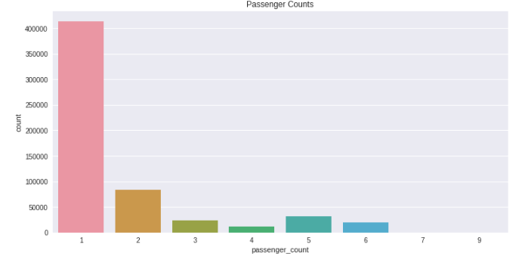
Passenger Count Bar Chart

Slide 9
Exploration of Trip Duration
Noticed that several trips had less than 60 seconds of duration
We filtered out these outliers so that the trips included in the data set were at least 1 minute long
data = data[ data['trip_duration'] >=61]
We then noticed that some trips were unusually long, and filtered the data by trip duration times
data[ (data['trip_duration'] <=86392) & (data['trip_duration'] >=40000)]
The trip duration was provided in seconds. We converted the duration times into both minutes and hours and added those trip durations to the data set
data['trip_duration_min'] = data['trip_duration']/60
data['trip_duration_hr'] = data['trip_duration']/60/60

Slide 10
Exploration of Trip Duration (continued)
Looking at the trip duration in hours, we rounded them to the nearest whole hour
data['trip_duration_hr_round'] = round(data['trip_duration_hr'], 0)
Put the trip duration hours into buckets to see the number of trips in each span of time:
data['trip_duration_hr_round'].value_counts().sort_index()
The results showed that most of the trips were less than an hour long…
And revealed outliers that are more than 24 hours long…
We removed trips greater than 24 hours from the data set
data = data[ data['trip_duration'] <=86392]
Trip Duration Hours | Number of Trips
0 | 534759
1 | 43831
2 | 387
Trip Duration Hours | Number of Trips
24 | 640
539 | 1
980 | 1

Slide 11
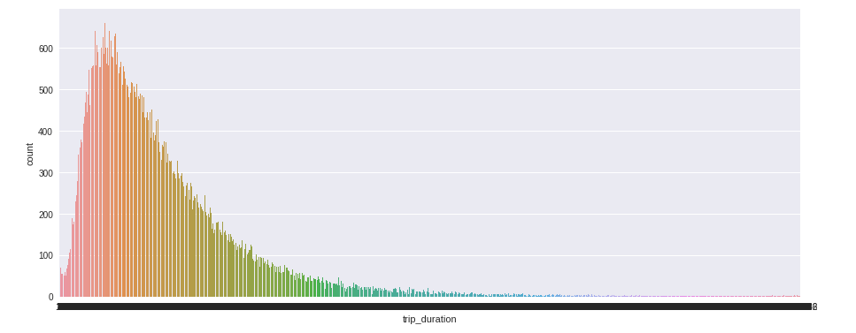
Original Trip Duration Chart Output

Slide 12
Exploration of Pickup and Dropoff Times
1. data['pickup_datetime'].hist(bins=60, figsize = (12,6))
plt.title("Pickup_datetime Histogram of Days")
2. data['dropoff_datetime'].hist(bins=60,figsize = (12,6))
plt.title("Dropoff_datetime Histogram of Days")
3. data['pickup_datetime'].dt.hour.hist(bins=24,figsize = (12,6))
plt.title("Pickup_datetime Histogram of Hours")
4. data['dropoff_datetime'].dt.hour.hist(bins=24,figsize = (12,6))
plt.title("Dropoff_datetime Histogram of Hours")
5. data['pickup_datetime'].dt.month.hist(bins= 12,figsize = (12,6))
plt.title("Pickup_datetime Histogram of Months")
6. data['dropoff_datetime'].dt.month.hist(bins= 12,figsize = (12,6))
plt.title("Dropoff_datetime Histogram of Months")
7. data['pickup_datetime'].dt.weekday.hist(bins= 12,figsize = (12,6))
plt.title("Pickup_datetime Histogram of weekday")
8. data['dropoff_datetime'].dt.weekday.hist(bins= 12,figsize = (12,6))
plt.title("Dropoff_datetime Histogram of weekday")

Slide 13
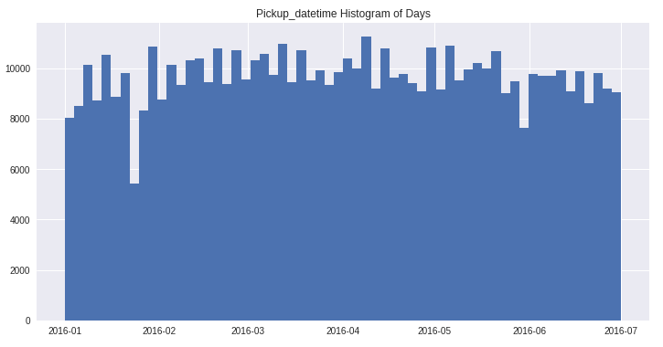
1. Histogram of Pickup Trip Days

Slide 14
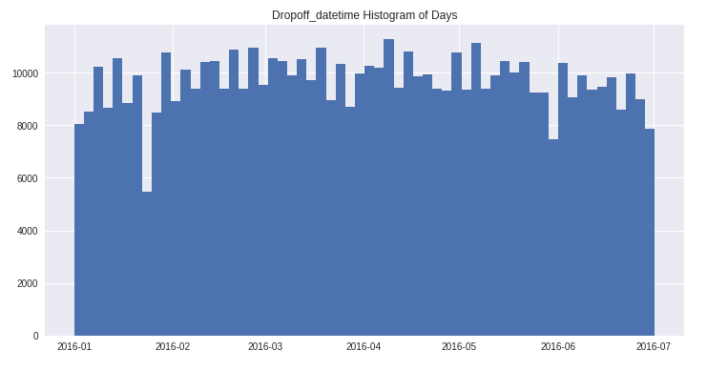
2. Histogram of Dropoff Trip Days

Slide 15
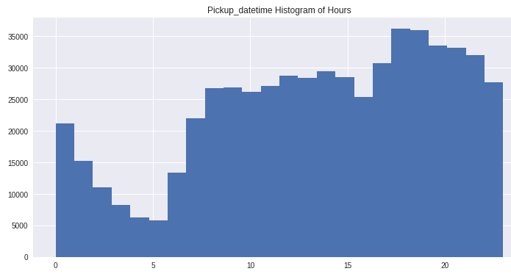
3. Histogram of Pickup Hours

Slide 16
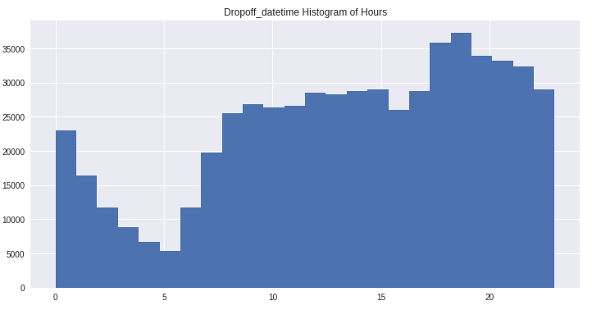
4. Histogram of Dropoff Hours

Slide 17
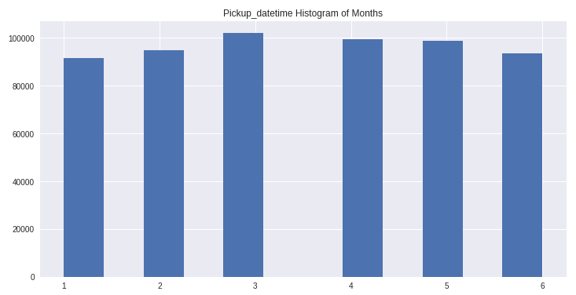
5. Histogram of Pickup Months

Slide 18
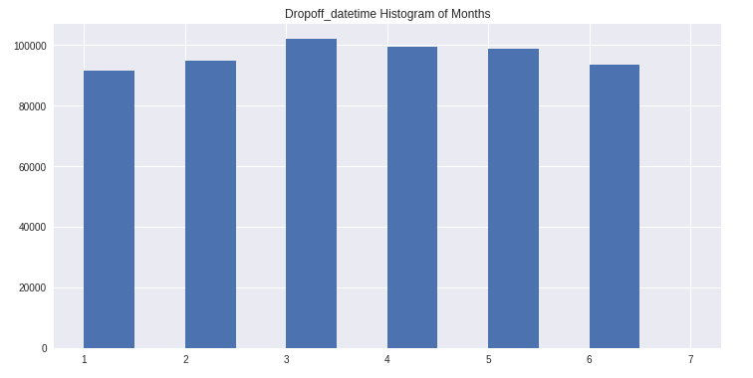
6. Histogram of Dropoff Months

Slide 19
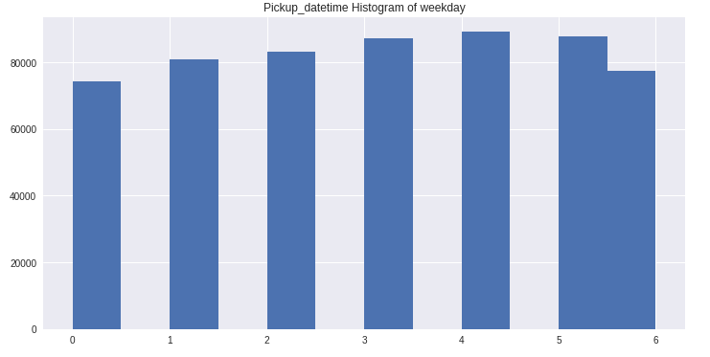
7. Histogram of Pickup Weekday

Slide 20
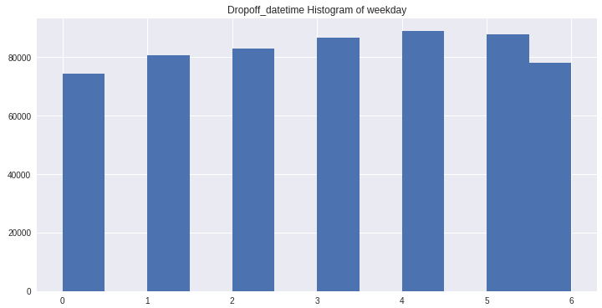
8. Histogram of Dropoff Weekday

Slide 21
Observations on Pickup and Dropoff Time Histograms
Pickup and dropoff ride counts tend to be lowest during the hour range between 1:00 and 6:00.
Pickup and dropoff ride counts tend to be highest during the evening hours closer to 20:00 and 24:00.
Pickup and dropoff ride counts tend to be similar across months.

Slide 22
Exploration of Vendor ID
Vendor ID refers to the operator of the trip tracking devices used by Yellow Taxi Company
We made a bar chart of the 2 vendors for comparison:
plt.figure(figsize=(12,6))
plt.title("Vendor ID Counts")
sns.countplot(x = 'vendor_id', data = data )
The vendor ID’s have almost equal number of trips

Slide 23
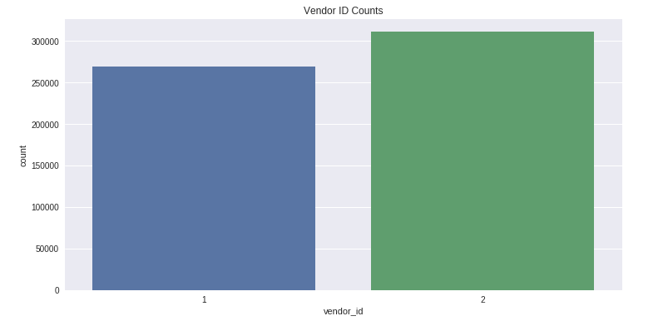
Vendor ID Bar Chart

Slide 24
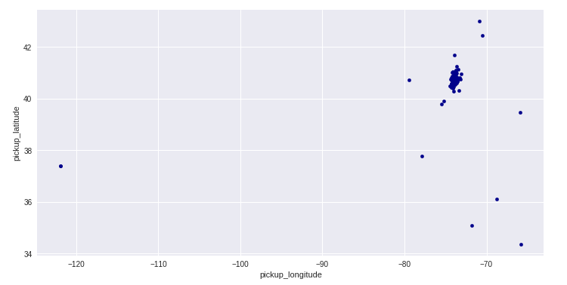
Exploration of Pickup Lat & Long
data.plot.scatter(x = 'pickup_longitude',
y = 'pickup_latitude',
c = 'DarkBlue',
figsize = (12,6))

Slide 25
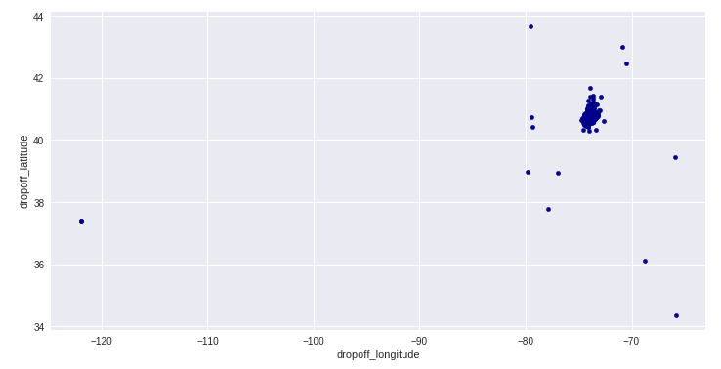
Exploration of Dropoff Lat & Long
data.plot.scatter(x = 'dropoff_longitude',
y = 'dropoff_latitude',
c = 'DarkBlue', figsize = (12,6))

Slide 26
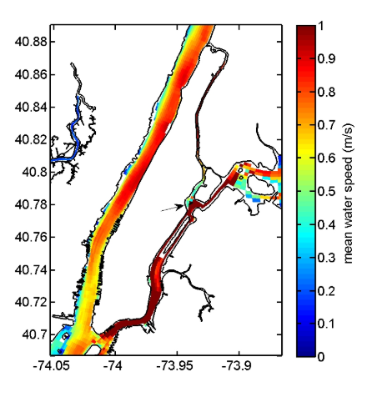
Observations & Next Steps
The scatter plots are showing outliers in locations
Some points are far away from the main cluster
We imported a chart of Manhattan that shows the latitude and longitude of the island…
Image(filename='meanvel1_tidal_manhattano.jpg',
width = 650,
height = 500)

Slide 27
Observations & Next Steps continued
The map shows the latitudes and longitudes we saw as outliers in our scatter plots are not in Manhattan, so we need to remove them from the pickup scatter plot…
data[(data['pickup_longitude'] > -74.5) &
(data['pickup_longitude'] < -73) &
(data['pickup_latitude'] > 39) &
(data['pickup_latitude'] < 41)
].plot.scatter(
x = 'pickup_longitude',
y = 'pickup_latitude' ,
c = 'DarkBlue', figsize = (12,6))
… and the dropoff scatter plot
data[(data['dropoff_longitude'] > -74.5) &
(data['dropoff_longitude'] < -73) &
(data['dropoff_latitude'] > 39) &
(data['dropoff_latitude'] < 41) ].plot.scatter(
x = 'dropoff_longitude',
y = 'dropoff_latitude',
c = 'DarkBlue', figsize = (12,6))

Slide 28
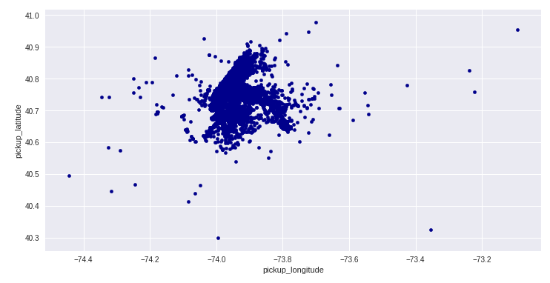
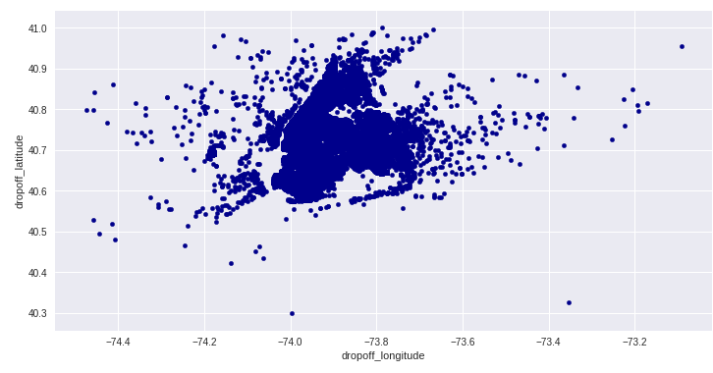
New Scatter Plots without outliers

Slide 29
Initial Model

Slide 30
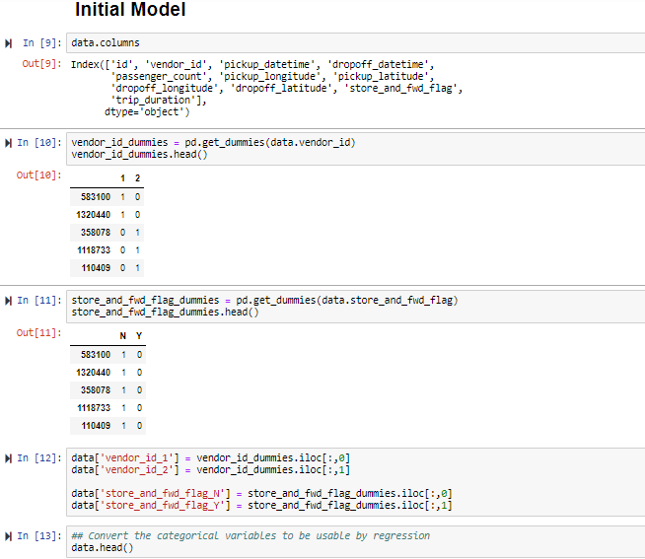

Slide 31
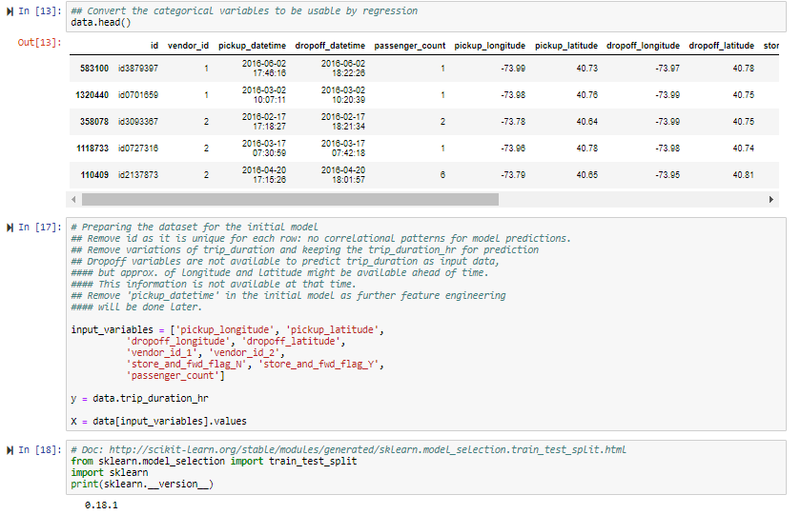

Slide 32
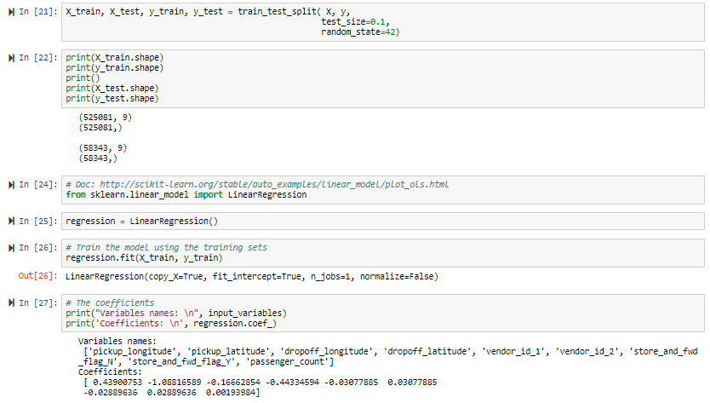

Slide 33
Evaluation

Slide 34
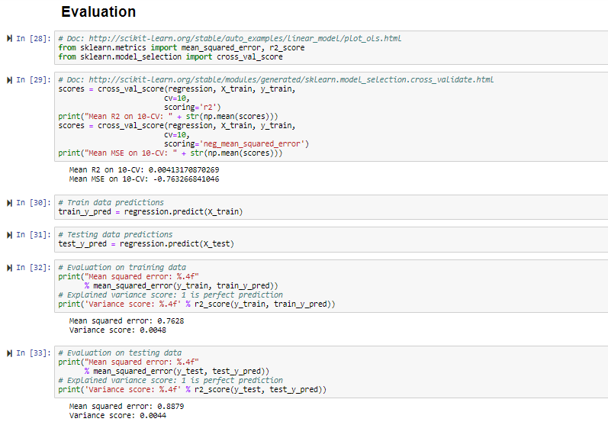

Slide 35
Feature Engineering

Slide 36
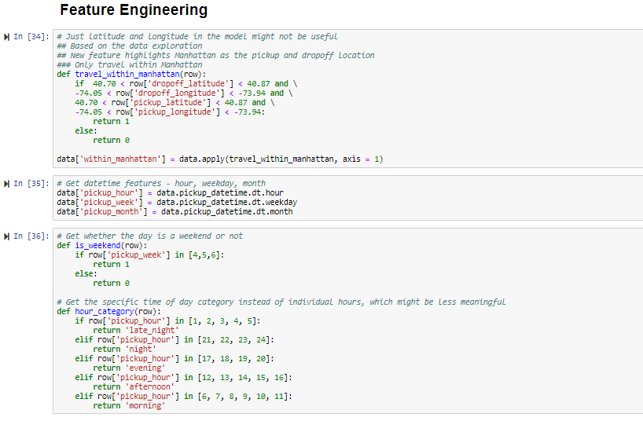

Slide 37
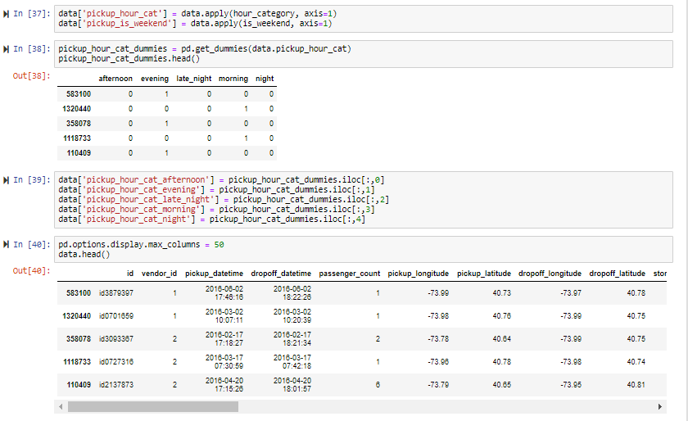

Slide 38
Model 2

Slide 39
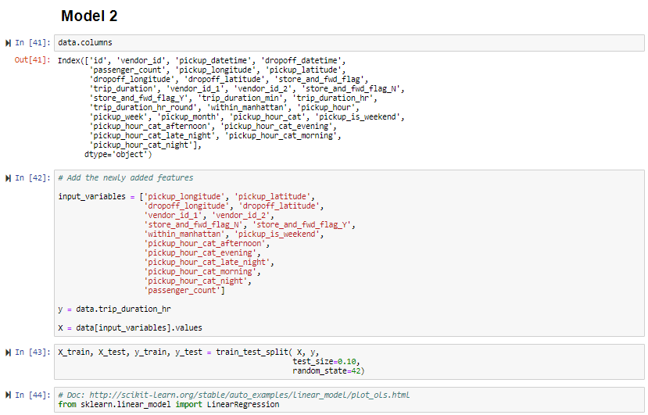

Slide 40
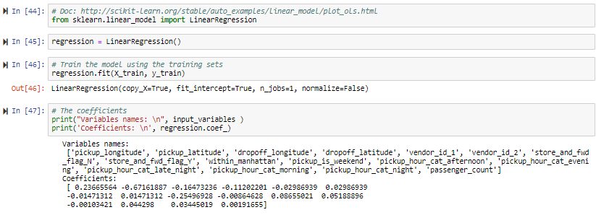

Slide 41
Evaluation

Slide 42
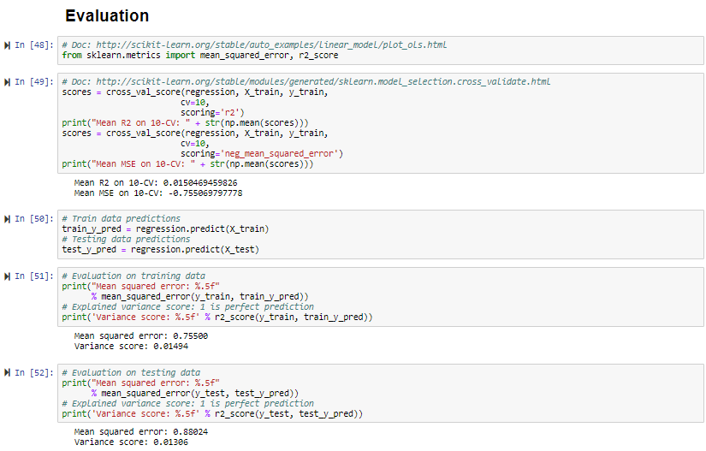

Slide 43
Further Investigation

Slide 44
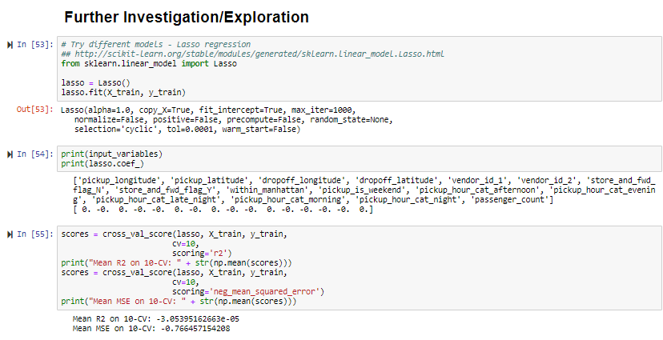

Slide 45
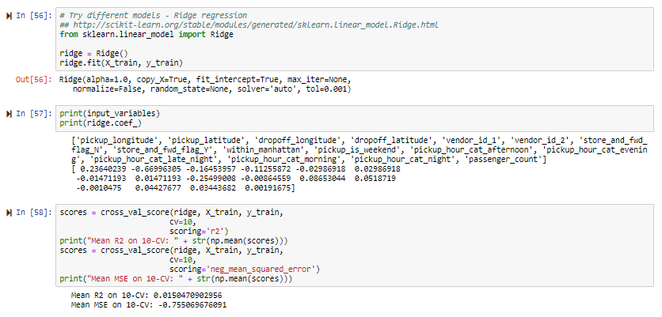

Slide 46
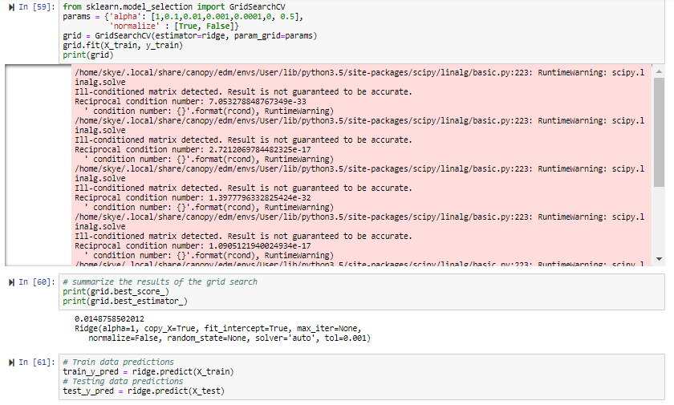

Slide 47
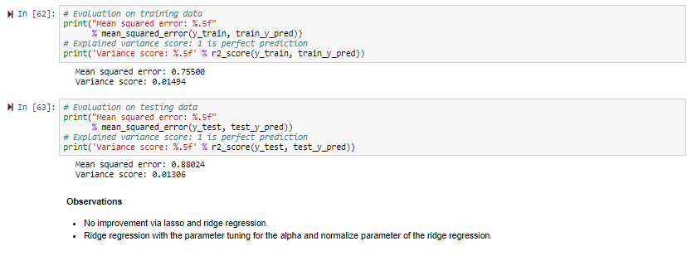

Slide 48
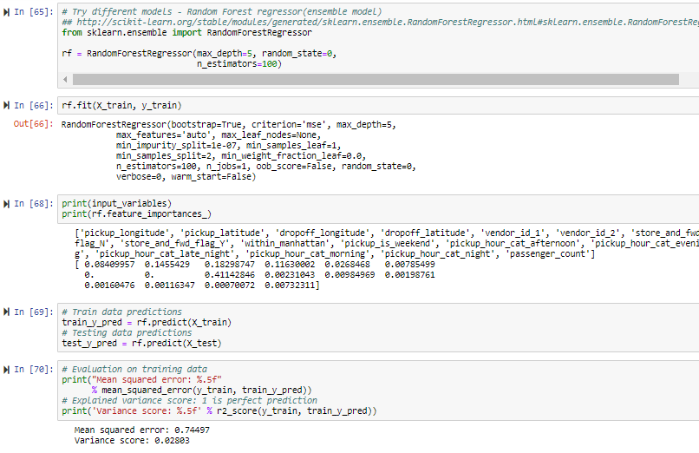

Slide 49
